Slide 1
Personal Narrative🌟📝🎭

Slide 2
Thesis Statement

Slide 3
Foods I like.
This a topic, but it isn’t a thesis statement.

Slide 4
I like food.
This is a statement about a topic (kind of), but it still isn’t a thesis statement.

Slide 5
I like food … a lot?
Try adding a list word and a structural lynchipin.

Slide 6
Uhhhh … a what?
Let me explain…

Slide 7
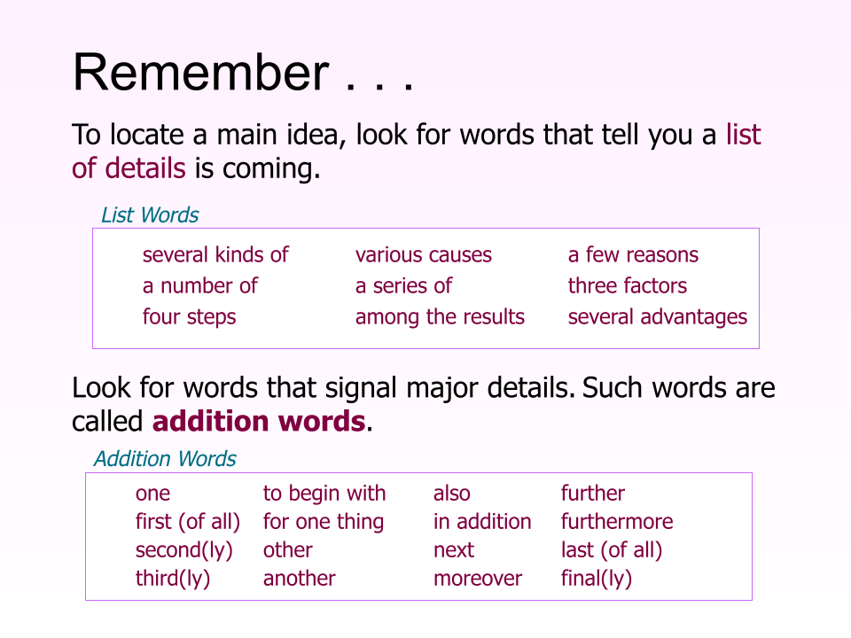

Slide 8
Adding a list word and a structural lynchipin will lock in the entire structure of the essay.
I like several types of food.

Slide 9
Adding only two words locks in the entire essay?
Does it seem too easy to be true? Or too unbelievable that two words would have such a large effect? Let me explain…

Slide 10
I like several types of food.
A list word indicates that each paragraph will be an item on the list.
A “structural lynchipin” is a thesis-level signal word that determines the structure of the entire essay.

Slide 11
I like several types of food.
Types → prompts classification → "One type... Another type..."
Reasons → prompts argumentation → "One reason... Another reason..."
Effects → prompts cause-effect → "One effect... Another..."
Ways → prompts process or method → "One way... Another way..."
Problems → prompts problem-solution → "One problem is... This solution addresses it..."
Examples → prompts illustration or narrative → "One example... Another example..."

Slide 12
I like several types of food.
One type of food I like is ____.
Another type of food I like is ____.
Finally, ____ is another type of food I like.

Slide 13
I like several types of food.
One type of food I like is [category 1].
Another type of food I like is [category 2].
Finally, [category 3] is another type of food I like.

Slide 14
I like several types of food, including [category 1], [category 2], and [category 3].
One type of food I like is [category 1].
Another type of food I like is [category 2].
Finally, [category 3] is another type of food I like.

Slide 15
If I have taken a position on a topic, and add a list word and a structural lynchipin, then I can outline the entire essay-level structure without knowing any of the content.

Slide 16
Categorizing Data

Slide 18
Organizing Data into Categories
Your task is to look at the items in the dataset and organize them into three categories of your choosing.
Step 1: Create three category names. These should make sense based on how you group the items.
Step 2: Place at least three items in each category.
Not every item needs to be used, and the categories do not need to be equal in size.
Categories should be parallel—they should reflect a single organizing principle.
This is a thinking activity, not a quiz. There are many valid ways to organize the same list.

Slide 19
Many Valid Organization Rationales

Slide 20
Organizing Data into Categories
Your task is to look at the items in the dataset and organize them into three categories of your choosing.
Step 1: Create three category names. These should make sense based on how you group the items.
Step 2: Place at least three items in each category.
Not every item needs to be used, and the categories do not need to be equal in size.
Categories should be parallel—they should reflect a single organizing principle.
This is a thinking activity, not a quiz. There are many valid ways to organize the same list.

Slide 21
Breaking Out of Binaries

Slide 22
How to Find Three or More Categories
Sometimes students naturally come up with binary categories—two opposite groups, like:
Sauce / No Sauce
Hot / Cold
Plant-based / Animal-based
But most assignments (like yours) require three or more non-overlapping categories. So how do we get there?

Slide 23
Strategy 1: Use “Maybe,” “Mixed,” “Neither,” or “Sometimes” as a Middle Zone
These in-between categories let you create a third option that is distinct (not vague).
Sauce
No sauce
Might use sauce (optional, mixed, or customizable meals like burritos, wings, sandwiches)
This makes the structure clear, inclusive, and non-overlapping.

Slide 24
Strategy 2: Borrow a New Structure for a Third Category
If you’re stuck in a two-part system, look at your items from a different angle. Pull one category from another organizing idea, as long as it doesn’t overlap.
A student organized by:
Fast Food
Slow-cooked
…but couldn’t find a third. Then they realized they could add:
Restaurant (sit-down meals)
Even though it's based on location, not prep time, it adds a third angle with minimal overlap.

Slide 25
Brainstorming

Slide 26
Brainstorming
List 10–15 things you like.
These may be a mix of more specific and more general things.

Slide 27
Organizing into Categories
Organize into 3 categories.
Include at least three items per category.
THEN
Write a thesis statement that covers all three categories.

